Slide 1
Lecture 4 – RPC/RMI

Slide 2
Topics
Introduction to Distributed Objects and Remote Invocation
Remote Procedure Call
Java RMI

Slide 3
Two main ways to do DC (apart from socket programming)
Remote Method Invocation (RMI)
Local object invokes methods of an object residing on a remote computer
Invocation as if it was a local method call
Event-based Distributed Programming
Objects receive asynchronous notifications of events happening on remote computers/processes

Slide 4
Remote Procedure Call (RPC)
Objects that can receive remote method invocations are called remote objects and they implement a remote interface.
Programming models for distributed applications are:
Remote Procedure Call (RPC)
Client calls a procedure implemented and executing on a remote computer
Call as if it was a local procedure

Slide 5
RPC Interfaces
Interfaces for RPC
An explicit interface is defined for each module.
An Interface hides all implementation details.
Accesses the variables in a module can only occur through methods specified in interface.

Slide 6
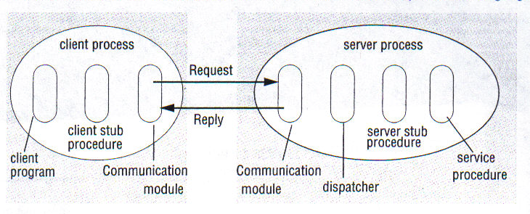
Remote Procedure Call (RPC)
Figure 3. Role of client and server stub procedures in RPC in the context of a procedural language
Couloris,Dollimore and Kindberg Distributed Systems: Concepts & Design Edn. 4 , Pearson Education 2005
Notes:
6

Slide 7
SUN ONC RPC
RPC only addresses procedure calls.
RPC is not concerned with objects and object references.
A client that accesses a server includes one stub procedure for each procedure in the service interface.
A client stub procedure is similar to a proxy method of RMI (discussed later).
A server stub procedure is similar to a skeleton method of RMI (discussed later).
Couloris,Dollimore and Kindberg Distributed Systems: Concepts & Design Edn. 4 , Pearson Education 2005
Notes:
7

Slide 8
Strength and Weaknesses of RPC
RPC (or even RMI) is not well suited for adhoc query processing. (e.g. SQL queries)
It is not suited for transaction processing without special modification.
A separate special mode of querying is proposed – Remote Data Access (RDA).
RDA is specially suited for DBMS.
In a general client_server environment both RPC and RDA are needed.
Notes:
8

Slide 9
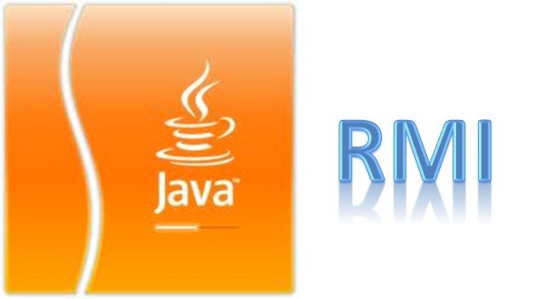
Notes:
RMI is copyrighted by Sun Micro system
Currently SUN is taken by Oracle, so, now this technology belongs to Oracle corporation.

Slide 10
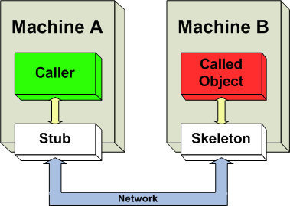
Java Remote Method Invocation
Fig: Distributed Object Technology
Notes:
Before discussing about Java RMI, the very first thing I would like to focus.
What is a distributed object technology (DOT)?
Also, what is the difference between web application and web service?
So, concept is pretty simple like this diagram.
When a machine can access the functionality of an object situated in a remote machine and exploit the computation power of the remote machine, then we can call it as a distributed object technology (DOT)
Java RMI is a perfect example of distributed object technology. Other similar types of technology is CORBA, SOAP etc.

Slide 11
When a machine can access the functionality of an object situated in a remote machine and exploit the computation power of the remote machine, then we can call it as a distributed object technology (DOT)
Java RMI is a perfect example of distributed object technology. Other similar types of technology is CORBA, SOAP etc.

Slide 12
Java Remote Method Invocation
RMI Server, client, interface, stubs, skeletons
RMI Registry
Objects + RPC = RMI
Method Invocation between different JVMs
Java RMI API
JRMP (Java Remote Method Protocol)
Java object serialization
Parameter Marshalling
Notes:
As mentioned, Java RMI is a distributed object based technology that means it provides object level abstraction to the developer.
For example, the developer needs to access some functionality of a remote object, Java RMI manages to allow the developers to call that remote object from his program just like a local class object. This was a cool thing when the concept was first started by Sun Microsystems and whole features were packaged as a Java Library with SDK.
It is also considered as an object version of Java RPC which provides procedure level abstraction to the developer.
Java RMI is basically a Java based technology and any machine containing JVM can host a distributed object server or client. However, it involves several components like service interface, RMI registry, skeleton, stubs etc which will discuss in the later slides.
The are also some advanced features related to RMI like object serialization, parameter marshalling on which we will try to provide some overview.

Slide 13
As mentioned, Java RMI is a distributed object based technology that means it provides object level abstraction to the developer.
For example, the developer needs to access some functionality of a remote object, Java RMI manages to allow the developers to call that remote object from his program just like a local class object. This was a cool thing when the concept was first started by Sun Microsystems and whole features were packaged as a Java Library with SDK.
It is also considered as an object version of Java RPC which provides procedure level abstraction to the developer.
Java RMI is basically a Java based technology and any machine containing JVM can host a distributed object server or client. However, it involves several components like service interface, RMI registry, skeleton, stubs etc which will discuss in the later slides.
The are also some advanced features related to RMI like object serialization, parameter marshalling on which we will try to provide some overview.

Slide 14
RMI System Architecture
Lets divide into two perspectives:
Layered Structure
Working Principles
Notes:
Lets focus on RMI architecture. The discussion will be two-folds:
Layered based architecture
Working principles based

Slide 15
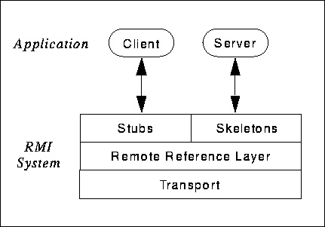
RMI Layered Structure
Fig: RMI Layered Structure
Notes:
Here, we can see a list of layers in the RMI protocol.
In the application layer, there are client and server who are the end-consumer and end-producer of the service. They communicate with intermediate layer called stub-skeleton layer.
In stub-skeleton layer, stub is related to client application which actually transmits the request to the next level. The skeleton is a component which is associated with server and is responsible to make the actual request to the server.
Remote reference layer contains the RMI registry and it works like a ORB in CORBA, that means, it handles the request and response between client and server. Once the client gets the remote object reference from the RMI registry, it can make request and this layer transmits that request to the appropriate server. Again, when server responds, it also sends back the response to the client. It also manages other advanced tasks like object activation , object serialization management, distributed garbage collection etc.
Transport layer handles network communication between client and server.

Slide 16
In the application layer, there are client and server who are the end-consumer and end-producer of the service. They communicate with intermediate layer called stub-skeleton layer.
In stub-skeleton layer, stub is related to client application which actually transmits the request to the next level. The skeleton is a component which is associated with server and is responsible to make the actual request to the server.
Remote reference layer contains the RMI registry and it works like a ORB in CORBA, that means, it handles the request and response between client and server. Once the client gets the remote object reference from the RMI registry, it can make request and this layer transmits that request to the appropriate server. Again, when server responds, it also sends back the response to the client. It also manages other advanced tasks like object activation , object serialization management, distributed garbage collection etc.
Transport layer handles network communication between client and server.

Slide 17
RMI Layered Structure
Application layer: Server, Client
Interface: Client stub, Server skeleton
Remote Reference layer: RMI registry
Transport layer: TCP/IP
Notes:
We have discussed these already.

Slide 18
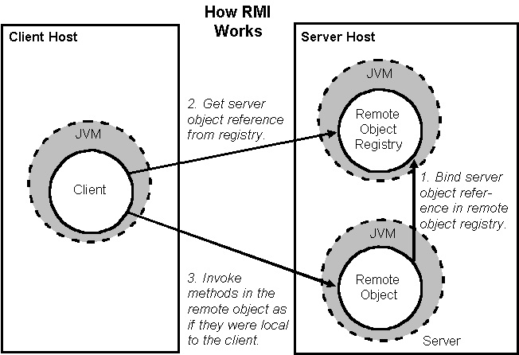
RMI Working Principles
Fig: RMI Working principles
Notes:
Now comes the working principles.
We can see the following steps:
Client requests for the remote object reference to naming service
Once the naming service locates the server host, RMI registry provides a stub (proxy) of remote object.
Client can make call using the stub
Basically, the request from the stub is sent to the server skeleton which makes the actual request to the remote object.
Similarly, the server response is sent back through skeleton and stub to the client.

Slide 19
Now comes the working principles.
We can see the following steps:
Client requests for the remote object reference to naming service
Once the naming service locates the server host, RMI registry provides a stub (proxy) of remote object.
Client can make call using the stub
Basically, the request from the stub is sent to the server skeleton which makes the actual request to the remote object.
Similarly, the server response is sent back through skeleton and stub to the client.

Slide 20

Ready to Develop One?
Notes:
Now, we will show how to develop a simple RMI application.

Slide 21
A Simple RMI Application
SERVER
Writing an Interface
Implementing an Interface
Binding Interface
CLIENT
Writing a Client
1
2
DEPLOYMENT
Manage Security Settings
Running Server & Client
3
Notes:
There are 3 major steps for this development.
Service contract establishment and server application development
Client application development
Deployment of service

Slide 22
There are 3 major steps for this development.
Service contract establishment and server application development
Client application development
Deployment of service

Slide 23
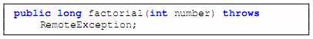
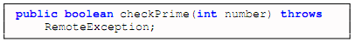
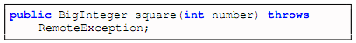
Service Interface: An Agreement Between Server & Client
Factorial Operation
Check Prime Operation
Square Operation
Notes:
First comes the service contract.
Suppose, the client and server are agreed upon this contract that there will be 3 operations:
Factorial operation
Prime check operation
Square operation
I kept the examples simple for easy understanding.

Slide 24
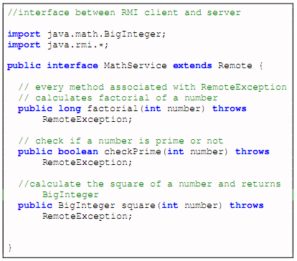
Server Application: Writing a Service Interface
Fig: MathService Interface
Notes:
And here is the complete interface. We developed it using Java interface. We named it MathService.

Slide 25
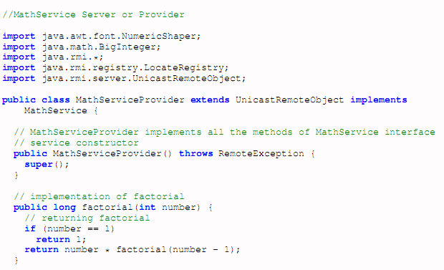
Server Application: Implementing the Service Interface
Notes:
Here, the server application implements the service interface.

Slide 26
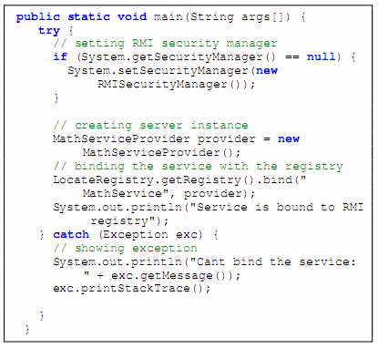
Server Application: Instantiating & Binding the Service
Notes:
This code binds the MathService to the RMI registry so that client app can get the reference of the service
And consume the service.
Interestingly, client can actually access the reference of interface MathService to make call,
however, the respond is provided by the object implementing the service.

Slide 27
A Simple RMI Application
SERVER
Writing an Interface
Implementing an Interface
Binding Interface
CLIENT
Writing a Client
1
2
DEPLOYMENT
Manage Security Settings
Running Server & Client
3
Notes:
Now comes the client application development.

Slide 28
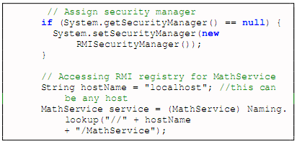
Client Application: Service Lookup
Fig: Client locating MathService service
Notes:
Here, we can see, client accesses the Naming. lookup() method to get the reference of the remote object.

Slide 29
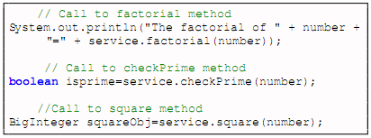
Client Application: Accessing Service
Fig: Client accessing MathService service
Notes:
Once it gets the reference, client can call the method just like it is calling a local object method.
This is the strength of Java RMI technology.

Slide 30
A Simple RMI Application
SERVER
Writing an Interface
Implementing an Interface
Binding Interface
CLIENT
Writing a Client
1
2
DEPLOYMENT
Manage Security Settings
Running Server & Client
3
Notes:
Now comes the deployment.

Slide 31


Server Deployment: Start RMI Registry
To start RMI registry on windows
To start RMI registry on Unix
Notes:
We need to start the RMI registry service to deploy the remote object; server object.

Slide 32
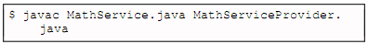
Server Deployment: Compile the Server
Compile both MathService interface and MathServiceProvider class
Notes:
Here we are compiling both service and server object.

Slide 33
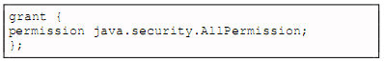
Security Deployment: Create Security Policy file (Both Client & Server)
Create a security policy file called no.policy with the following content and add it to CLASSPATH
This step implies for both server and client
Notes:
Now comes the crucial part on which often most of time we get stuck.
That is the security policy of Java RMI.
The default security does not support the RMI call, so, we need to set custom permission for the call to the security manager.
This phase is required for both the client and server.
Basically, we have to create a <any name>.policy file with this content. Here, we allowed all types of call associated with Java RMI;
That is why it contains AllPermission.

Slide 34
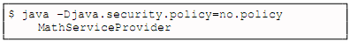
Start the Server
Execute the command to run server
Notes:
This is how the server object should be deployed.

Slide 35
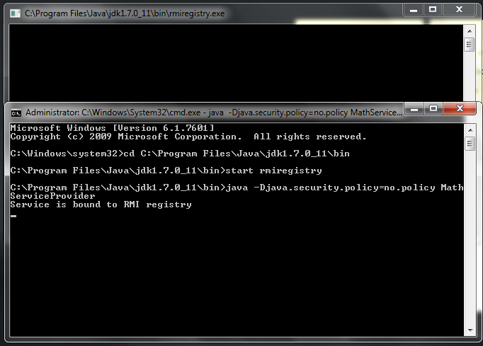
Server Running
Notes:
This is how we did.

Slide 36
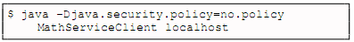
Start the Client
Execute the command to run client
Notes:
This is how the client needs to be run for RMI service access. Please note that we have to specify the host name.

Slide 37
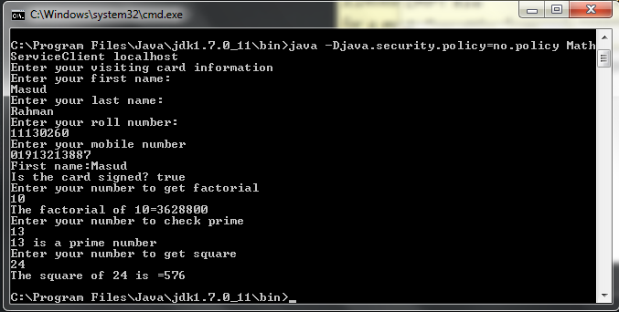
Client Interface
Notes:
This is how we did for the client. However, we also developed the Java object serialization by this time.

Slide 38
Java RMI notes
Java Object Serialization
Parameter Marshalling & Unmarshalling
Object Activation
- Singleton
- Per client
- Per call
Notes:
There are advance stuffs which I would like to provide some overview.
Java Object serialization: It involves converting the object into a sequence of byte streams where there needs a swapping of java object between client and the server. Basically, if client or server uses a user-defined class as parameters, then they need the object serialization.
Parameter Marshalling is a type of serialization for parameters handled by the stub-skeleton layer. Demarshalling refers to de-serialization.
Object Activation: In some scenarios, server may not be running always, then object reference layer activates the target remote object (server) to enable it to respond to the client’s request. Common for infrequent RMI call.
The detail discussion of those topics is beyond this tutorial, because each of them will be a single tutorial.

Slide 39
Strength Of Java RMI
Object Oriented: Can pass complex object rather than only primitive types
Mobile Behavior: Change of roles between client and server easily
Design Patterns: Encourages OO design patterns as objects are transferred
Safe & Secure: The security settings of Java framework used
Easy to Write /Easy to Use: Requires very little coding to access service
Notes:
These are strengths of Java RMI.
-Object oriented, object level abstraction.
-Mobile behavior: that means the roles between client and server can be exchanged easily.
-It supports the design pattern
-sate and secure like the Java technology.

Slide 40
Strengths Of Java RMI
Connects to Legacy Systems: JNI & JDBC facilitate access.
Write Once, Run Anywhere: 100% portable, run on any machine having JVM
Distributed Garbage Collection: Same principle like memory garbage collection
Parallel Computing: Through multi-threading RMI server can serve numerous clients
Interoperable between different Java versions: Available from JDK 1.1, can communicate between all versions of JDKs
Notes:
-It can support the legacy system.
-Write once, run everywhere
-Distributed garbage collection, like the one provide by Java.
-facilitates the parallel computing.
-Widely supported by different versions of JDK, as it was from the beginning, JDK 1.1

Slide 41
Weaknesses of Java RMI
Tied to Java System: Purely Java-centric technology, does not have good support for legacy system written in C, C++, Ada etc.
Performance Issue : Only good for large-grain computation
Security Restrictions & Complexities: Threats during downloading objects from server, malicious client request, added security complexity in policy file.
Notes:
It also got some weaknesses.
-Tied to Java system, that means it a Java only technology, cant communicate well with the non-java platform.
-Due to byte code step, the computation is slower.
-Additional complexity for security which many developers didn’t like.
-Extra step with rmic compilation

Slide 42
.NET Remoting
.NET equivalent of Java RMI
Uses Windows registry as the registry service
Java RMI supports more communication protocols and .NET remoting
.NET remoting creates proxies at runtime similar to RMI
Notes:
It also got some weaknesses.
-Tied to Java system, that means it a Java only technology, cant communicate well with the non-java platform.
-Due to byte code step, the computation is slower.
-Additional complexity for security which many developers didn’t like.
-Extra step with rmic compilation

Slide 43
Conclusion
RMI/RPC makes it easier to build distributed systems with programmers not having to worry about network comm. (sockets, etc)
.NET Remoting
No interoperability (Java only due to binary messages used)
Notes:
So, we have got couple of conclusions to make.
Discuss on your own.

